Slide 1

Building a test system based on PXI Matrix Switch modules

Slide 2
Minimum requirements to build a test
Voltage measurement
Resistance measurement
Arbitrary voltage source
Current measurement (rare)

Slide 3
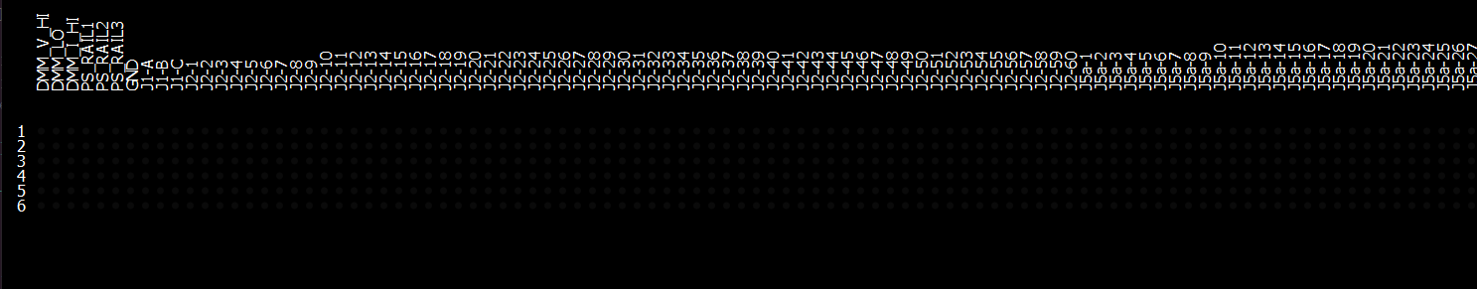
How to perform routing using a matrix?
Each matrix has a long X dimension and a shorter Y dimension
Stack multiple modules by connecting rows
Place switchable resources on X axis
Do not place anything on Y axis…
… until it is time to route!
X
Y

Slide 4
How to perform routing using a matrix?
Use Y-axis rows to make arbitrary connections between X-axis columns
Each net requires a single row

Slide 5
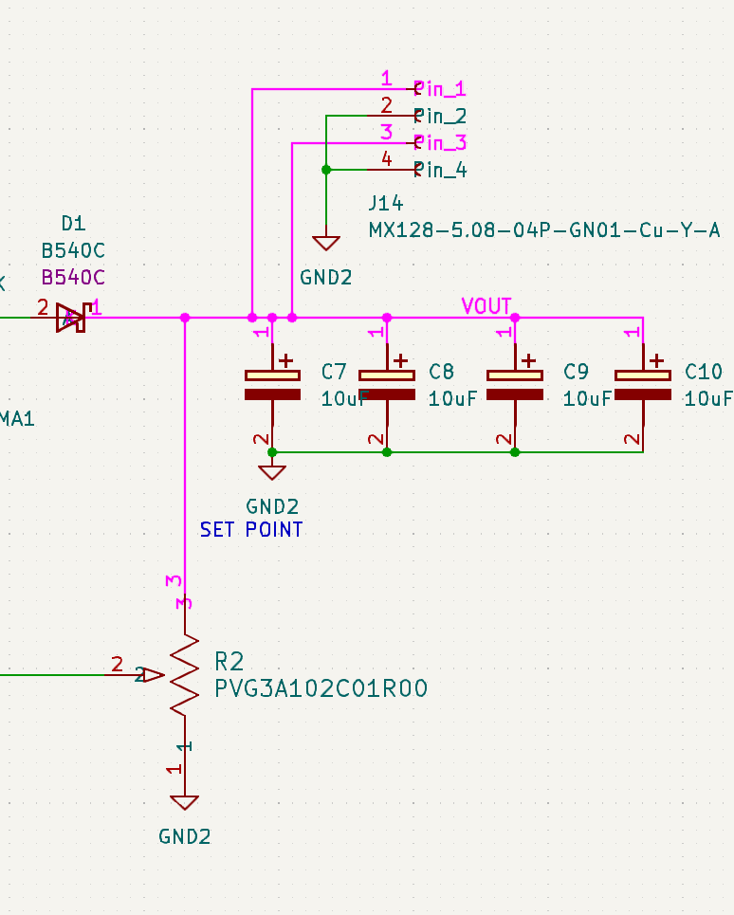


Aside Q: What is a net? A: A net is a description of connectivity.
Formally, a net is a set of connected nodes.
Circuit may contain multiple nets.
Nets are disjoint sets, meaning a node can only belong to one net.

Slide 6
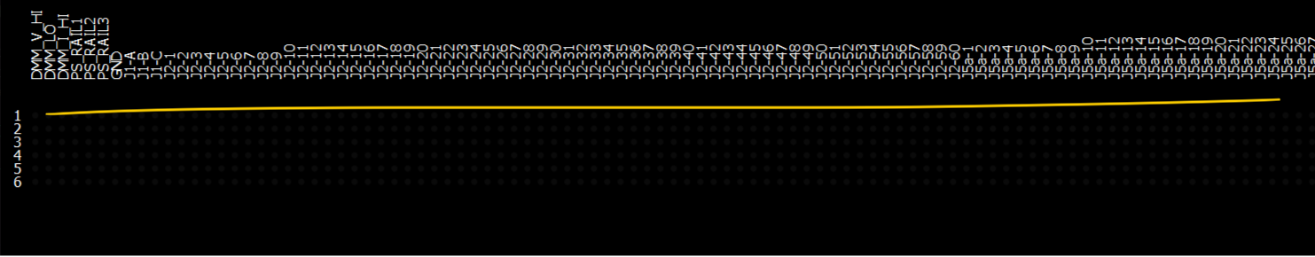
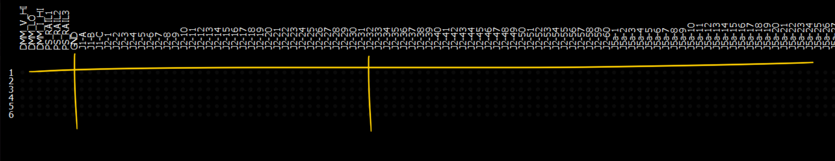
Example: Connect J2-32 to GND
Pick an unused row
Intersect J2-32 column with the row
Turn the relay at intersection on

Slide 7
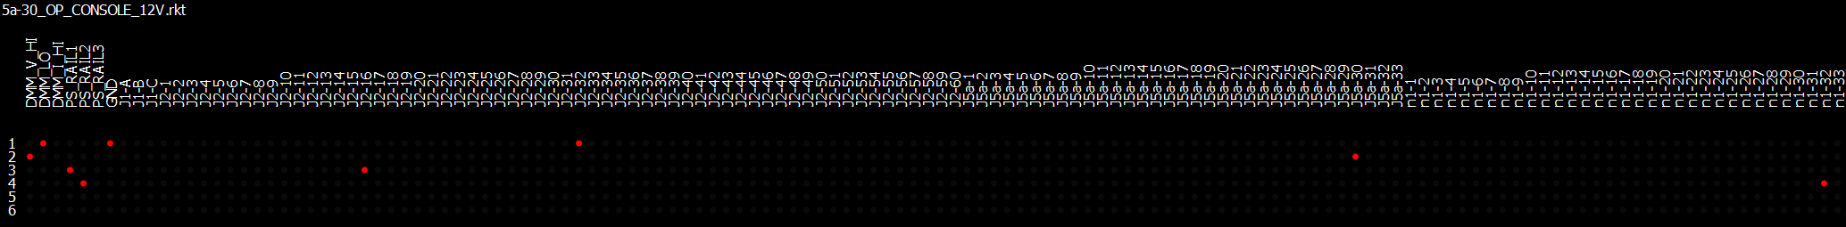
How big does the matrix need to be?
Tiger control box requires 204 targets
In addition to 7 tester targets
For a total of 211 targets on X-axis
Y-axis requirements depend on number of simultaneous nets in a test
Maximum Y-axis usage was 4 in simulations
A Y-axis of 6 would be preferred.

Slide 8
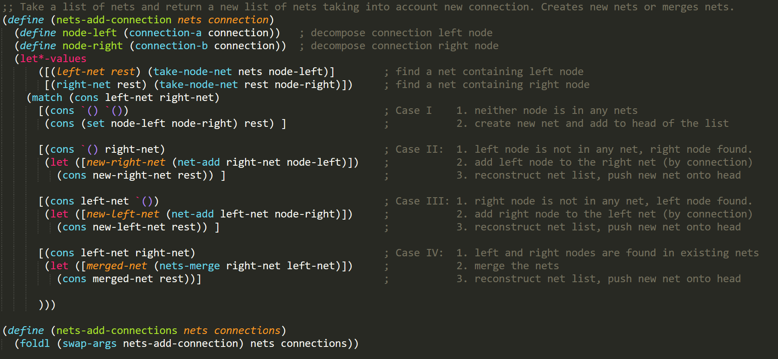
Build your own matrix router in two LISP calls:
Routing matrix was implemented in LISP in two functions
First one builds nets from connections

Slide 9
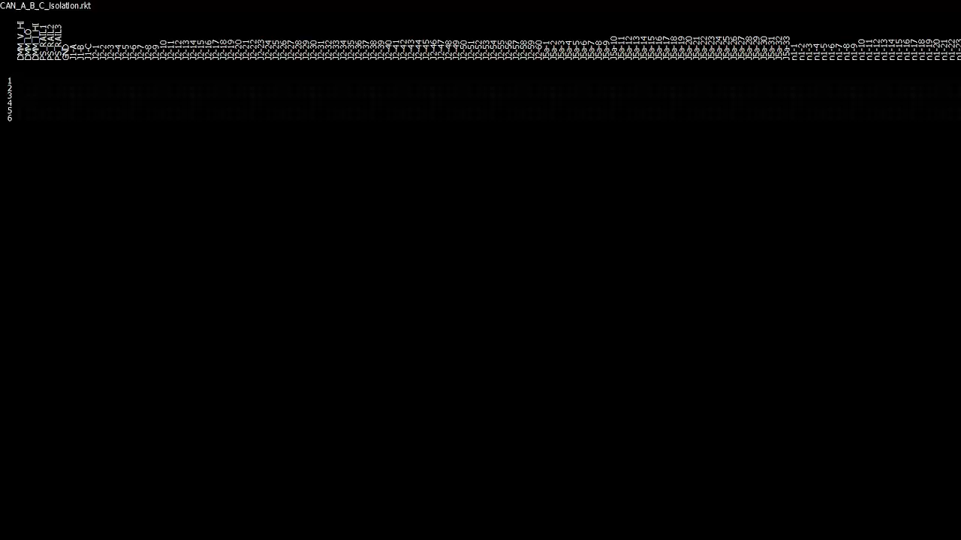
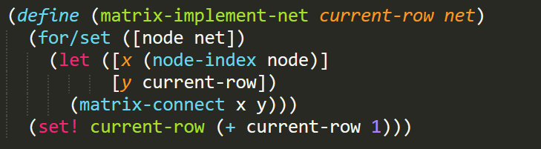
Build your own matrix router in two LISP calls:
Second one, flips the relays on…

Slide 10

Q:What are these nodes? A:$$$$
The 7 test targets are dedicated to test resources
DMM_V_HI is Voltage Probe +
DMM_LO is DMM Ground
DMM_I_HI is DMM Current Probe +
PS_RAIL1,2,3 are adjustable power supply controlled by the test
GND
free

Slide 11
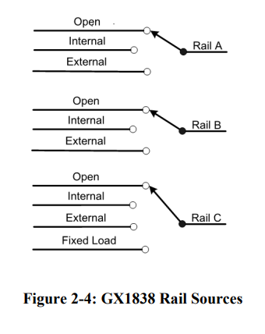

PXI Power Supply
Possible candidate for adjustable power supply
500 mA, up to 32V
Ideal test signal source
Not great for switching large relays

Slide 12

PXI Power Supply
2 Channel
2A, 48V
Great, but could use more channels

Slide 13

PXI SMUs: Precision Sources
Higher-precision sources are called SMU (Source Measure Units)
Typically, low voltages/currents

Slide 14
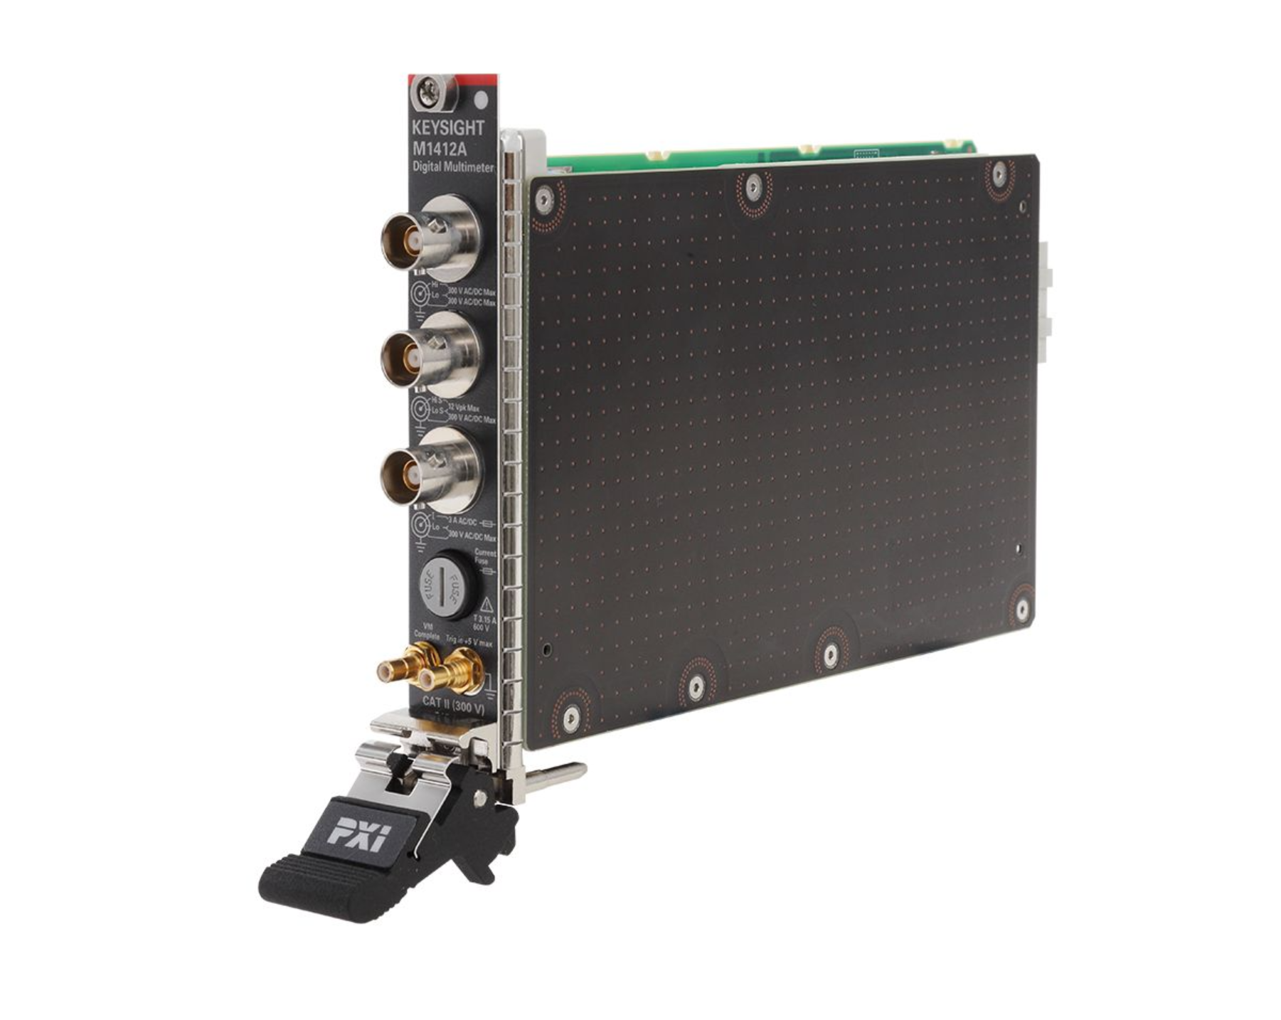
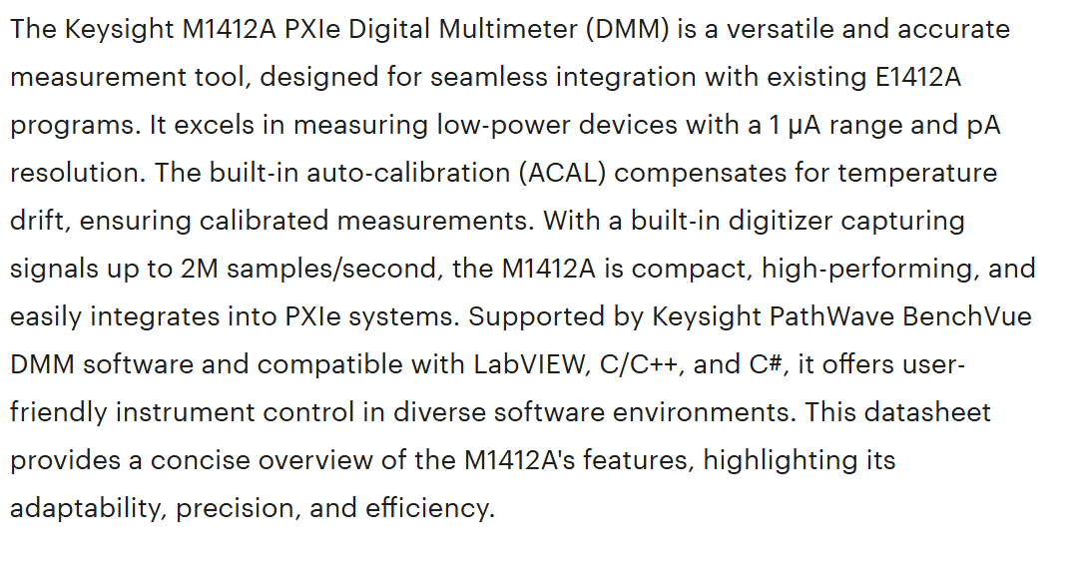
PXI DMM (Digital Multimeters): M1212A – High End
M1412A
7.5 Digit
Costs $8793

Slide 15

PXI DMM (Digital Multimeters): Other options from Keysight

Slide 16
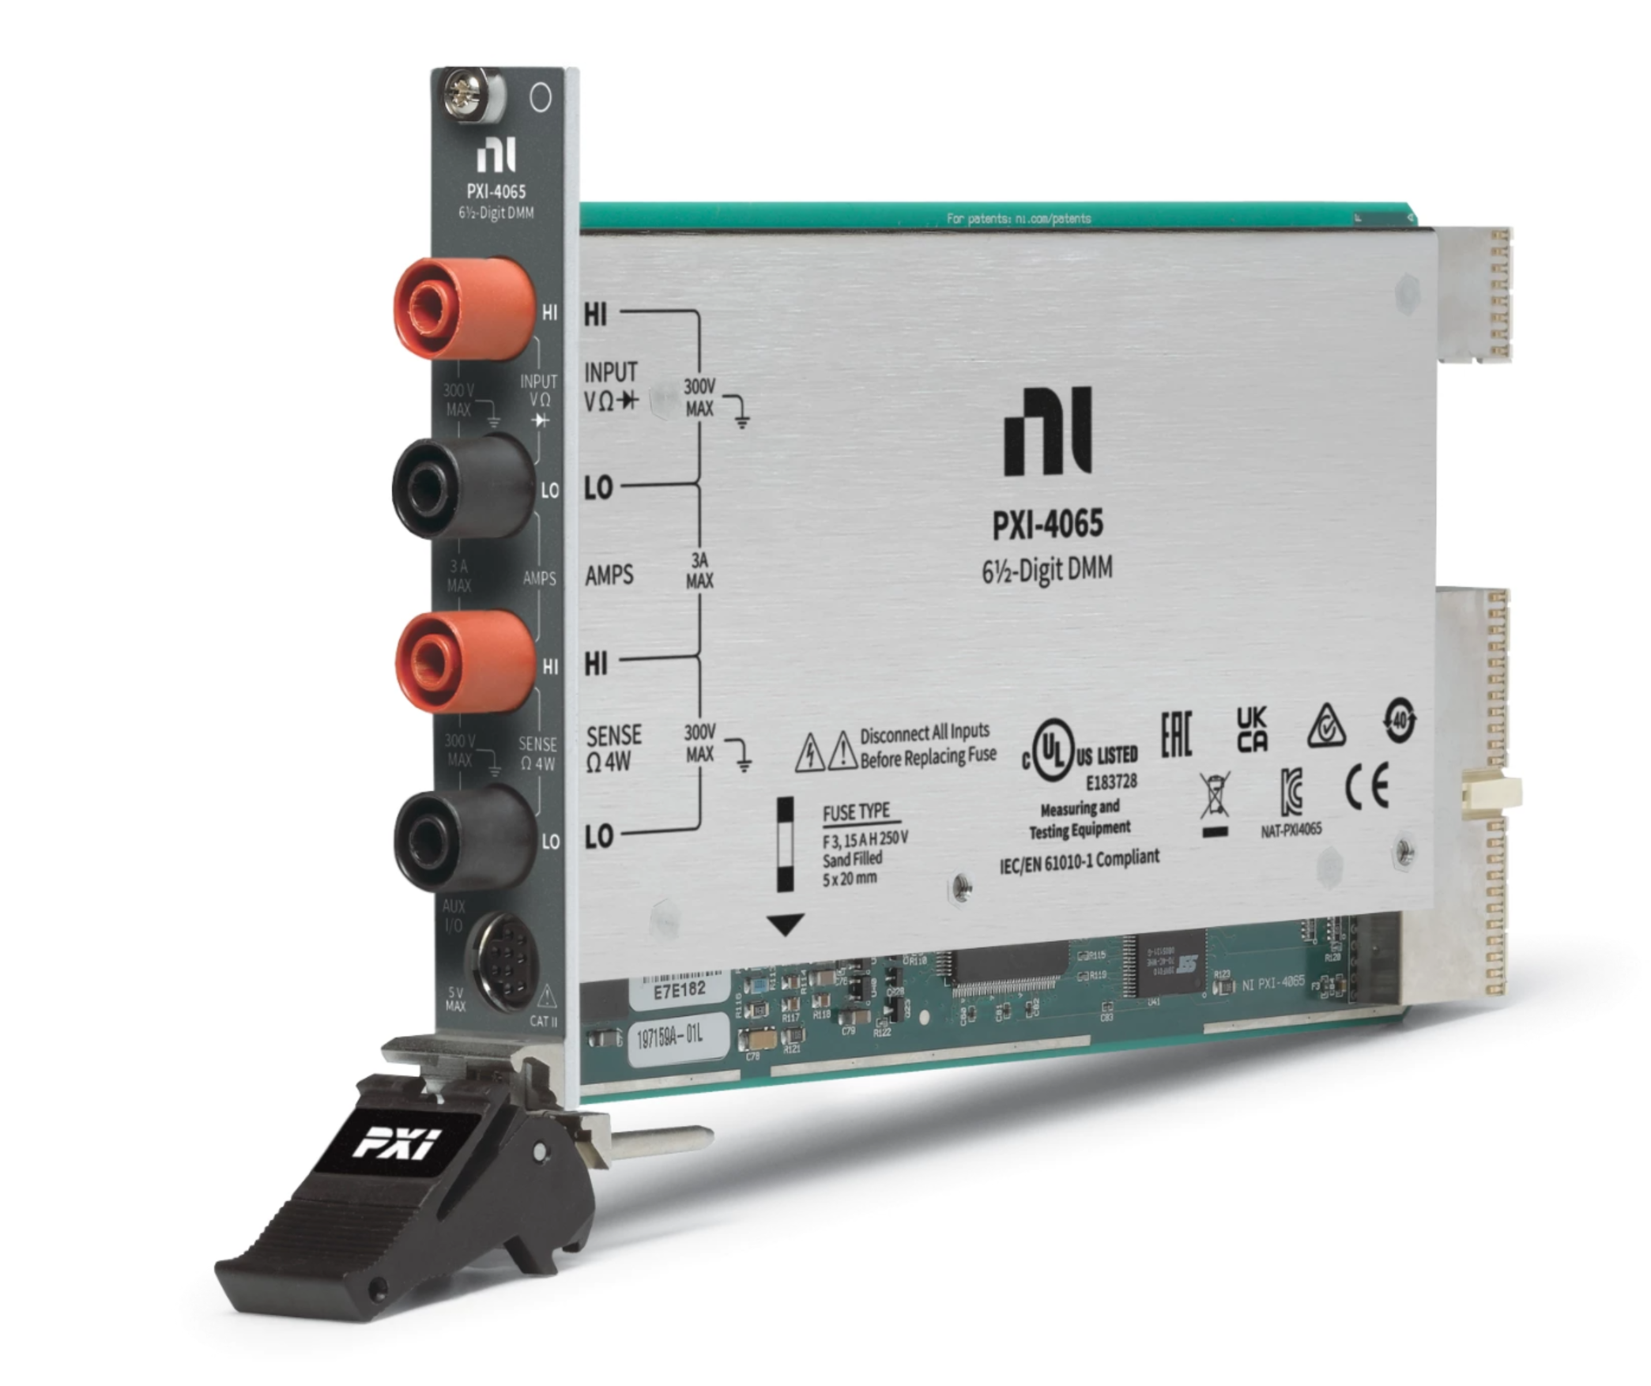
PXI DMM (Digital Multimeters): NI PXI-4065
6.5 Digit
Costs $2085

Slide 17
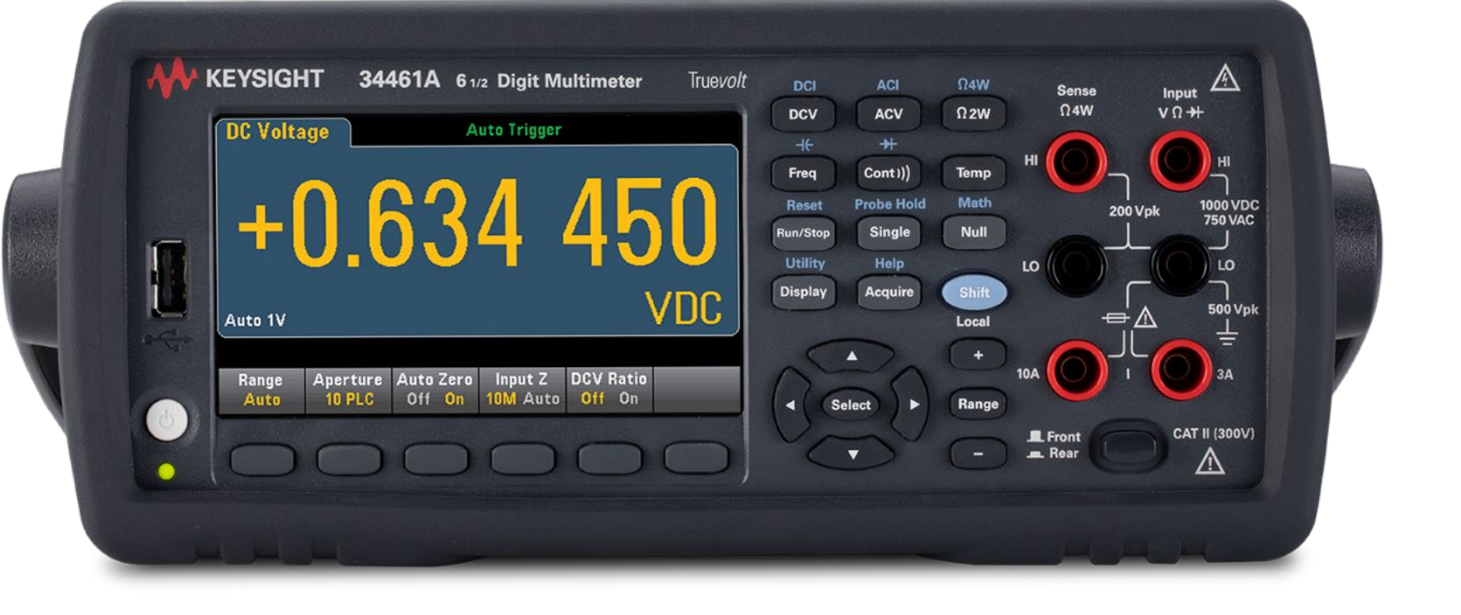
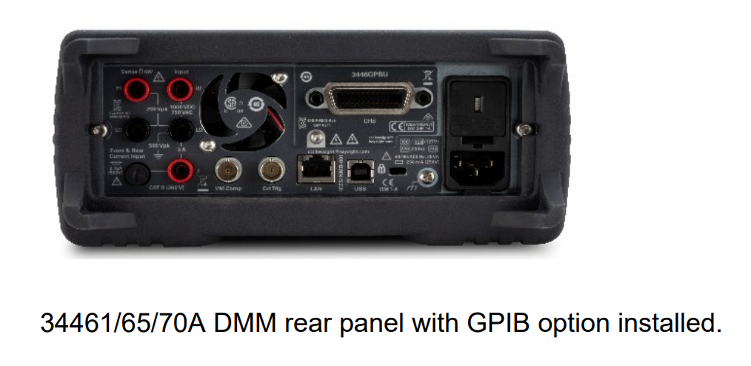
Bench Top DMM (Digital Multimeters): Other options from Keysight
6.5 Digit
Ethernet, USB
Rear probe jacks
Costs $1865

Slide 18
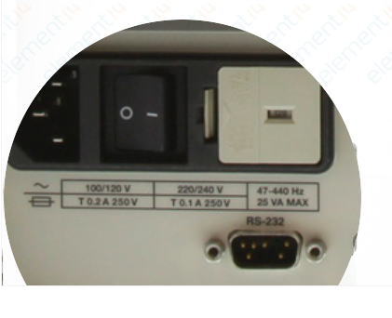
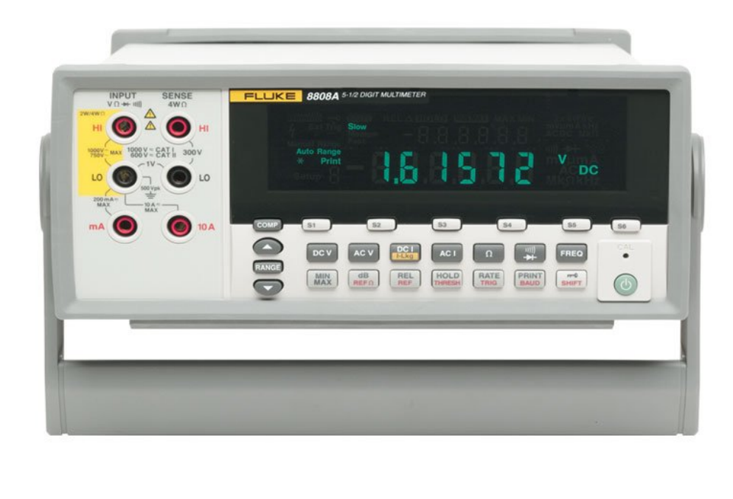
Bench Top DMM (Digital Multimeters): And then there’s Fluke
5.5 Digit
Ethernet, USB Serial
Rear probe jacks
Costs $1360

Slide 19
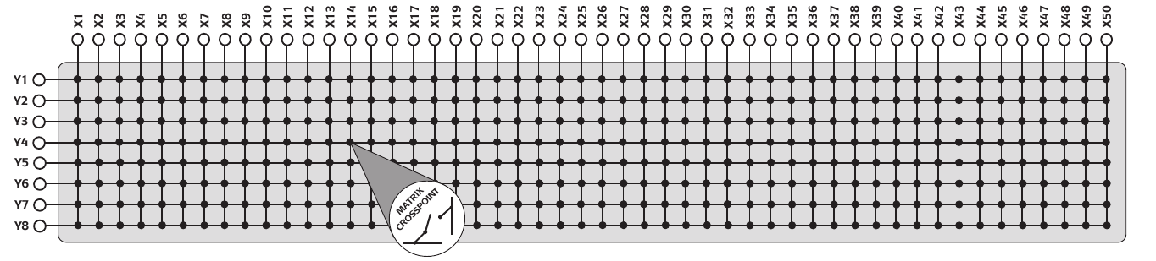
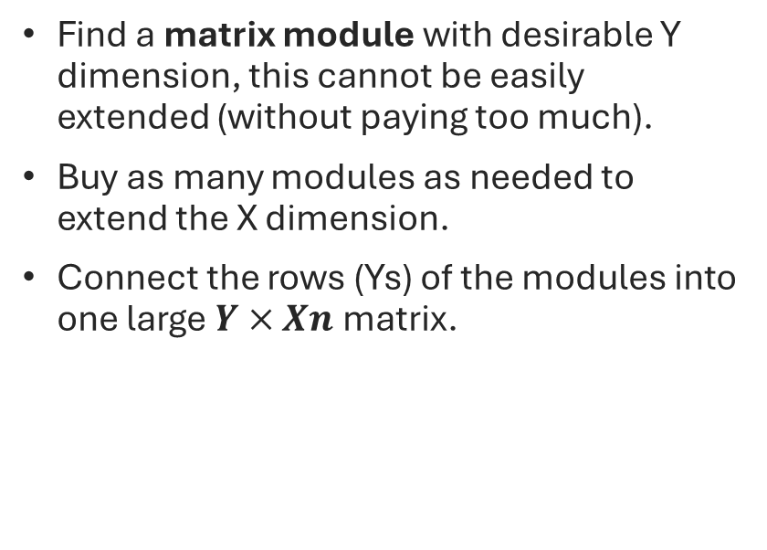
Q:Where do you get a 6x211 matrix? A:You buy the 6 part and build the 211 part.
Find a matrix module with desirable Y dimension, this cannot be easily extended (without paying too much).
Buy as many modules as needed to extend the X dimension.
Connect the rows (Ys) of the modules into one large $Y×Xn$ matrix.

Slide 20

4x64 Matrix Option from Pickering
Having 4 rows in Y-axis is very limiting
Need x4 modules for 256 targets on X axis
2A current

Slide 21

6x64 Matrix Option from Marvin
Having 6 rows in Y-axis is nice
Still need x4 modules for 256 targets on X axis
Only 500 mA current

Slide 22
Defining Common Test Language: The useful subset.
connect two nodes a and b together
measure voltage between a and b nodes
measure resistance from a to b
apply-voltage v to node a
Connectivity | Power | Measurement
(connect a b) | (power-supply-set rail v) | (dmm-v)
(disconnect a b) | (power-supply-on rail) | (dmm-i)
(disconnect-all) | (power-supply-off rail) | (dmm-r)
 | (apply-voltage a v) | (voltage a b)
 | (remove-voltage a) | (resistance a b)
 | (apply-ground a)

Slide 23
Defining Common Test Language: The primitive subset.
connect two nodes a and b together
Take dmm-voltage reading depending on where DMM_V_HI and DMM_V_LO are connected
Take dmm-resistance reading depending on where DMM_V_HI and DMM_V_LO are connected
Manually control power-supply nodes with …-set, on, off
Connectivity | Power | Measurement
(connect a b) | (power-supply-set rail v) | (dmm-v)
(disconnect a b) | (power-supply-on rail) | (dmm-i)
(disconnect-all) | (power-supply-off rail) | (dmm-r)
 | (apply-voltage a v) | (voltage a b)
 | (remove-voltage a) | (resistance a b)
 | (apply-ground a)

Slide 24
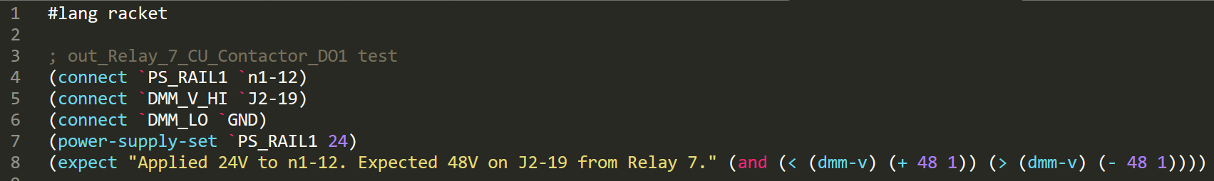
Structure of a Test Case
A test case is a small program written in Scheme language (Racket)
Constructs a circuits using relay matrix (connect)
Controls test power sources (power-supply-set…, on, off)
Performs measurement using DMM (Digital Multi Meter) (dmm-v, , r)
Evaluates test expression (expect)
Displays an error message if test expression is #f (false).

Slide 25
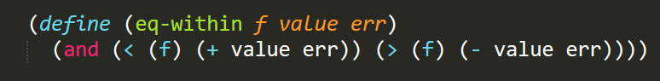
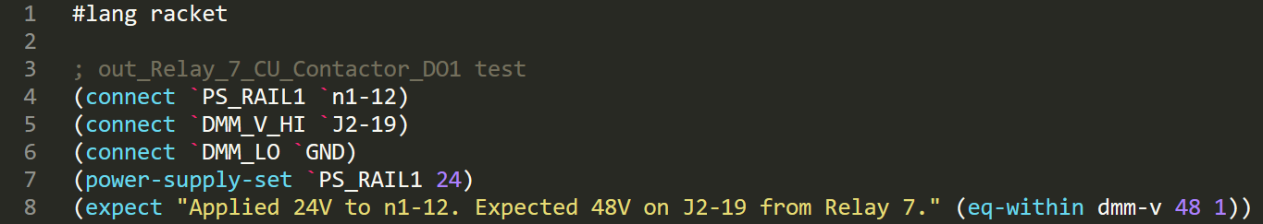
Simplifying Common Patterns
Using Racket you can factor our common code patterns to make tests less repetitive
Functions in Racket are short and sweet
DRY (Do Not Repeat Yourself)

Slide 26
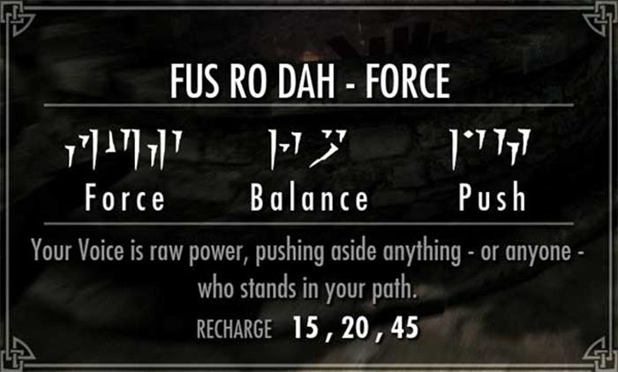
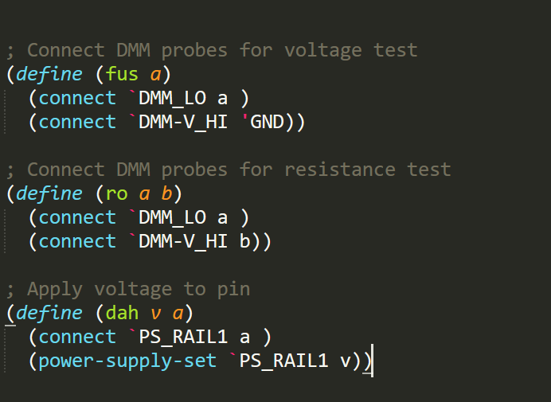
Simplifying Common Patterns
Shape your own language to solve problems efficiently, don’t shape your problems to the language

Slide 27
Test Expression Language
Connectivity | Power | Measurement
(connect a b) | (power-supply-set rail v) | (dmm-v)
(disconnect a b) | (power-supply-on rail) | (dmm-i)
(disconnect-all) | (power-supply-off rail) | (dmm-r)
 | (apply-voltage a v) | (voltage a b)
 | (remove-voltage a) | (resistance a b)
 | (apply-ground a)
Defining a common language foundation makes the tests simpler.

Slide 28
Why Test Cases are different from normal software?
Test are written to fail! - If your test can’t fail, you don’t need the test.
Full code of the test must be VISIBLE to the operator!!! - If I don’t understand the test, I can’t fix it.
Tests are written to be debugged. - I want to interact with the tester to reproduce the problem.
Tests are not written to test the tester. - I need to trust the tester to do the right thing.

Slide 29
It may seem beneficial to scan every pin and do pair-wise resistance testing between each test to catch cross-talk. This could be achieved by restructuring many tests to alter a background snapshot of voltage and pairwise resistance across the whole target and then compare measured snapshot to the expected snapshot.
The downside of such setup is slower testing speed, complexity of troubleshooting when issues arise and reduced flexibility. If the test touched 100 relays, how do I know which one caused the problem? The programmers will say “I will write an error message”. But we all know programmers can’t write meaningful error messages and you can’t rely on that to save your life. Far more beneficial is to test what you actually care for and to keep tests simple.

